Slide 1
Digi Sense
How To prepare and connect

Slide 2
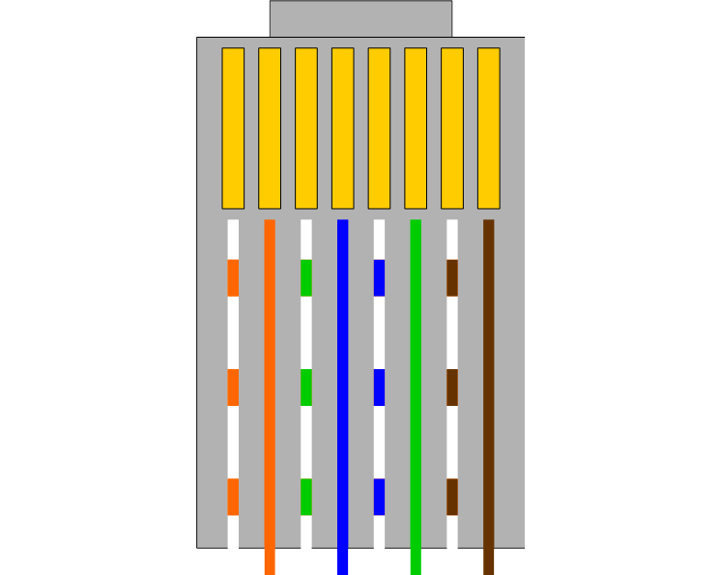
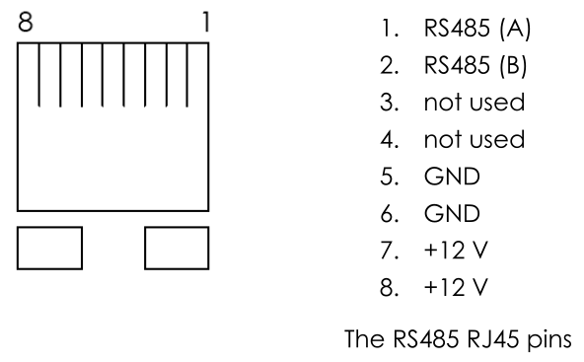
ETH connector
T-568B cable
Connects to mux like this according to docs:
connect to PSU
This is the plug

Slide 3
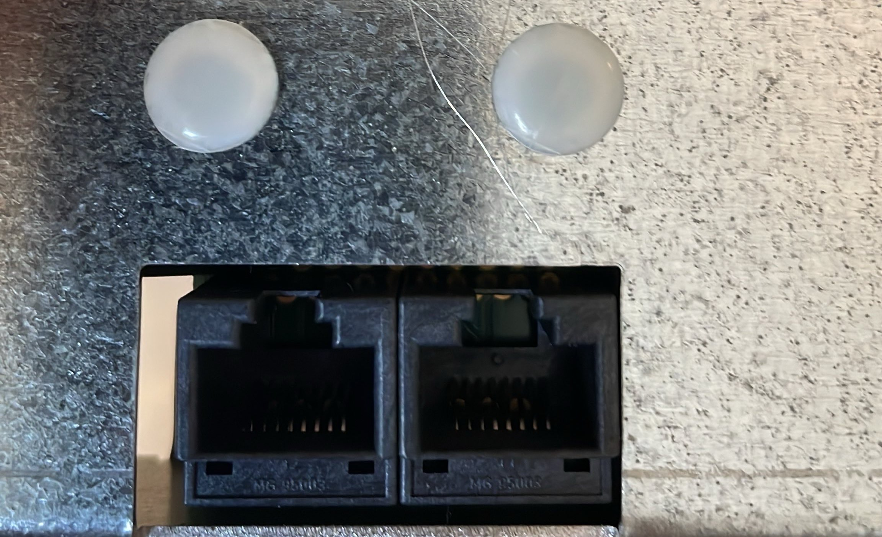
1 2 3 4 5 6 7 8

